Slide 1
Calcium and phosphate homeostasis
Mahmoud Alfaqih BDS PhD

Slide 2
Introduction
Calcium is the most abundant mineral in the human body
99% of the calcium in the human body is found in bones in the form of hydroxyapatite.
The remainder is distributed in the soft tissues, teeth, and extracellular fluid.

Slide 3
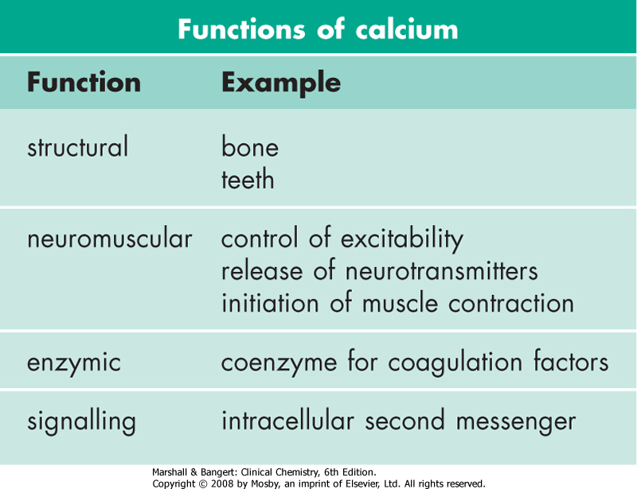
Functions of calcium

Slide 4
Calcium and bone
Bone consists of osteoid, a collagenous organic matrix, on which is deposited complex inorganic hydrated calcium salts known as hydroxyapatites.
Even when growth has ceased, bone remains biologically active.
Continuous turnover ('remodelling') occurs with bone resorption (mediated by osteoclasts) being followed by new bone formation (mediated by osteoblasts).
At any one time, about 5% of bone mass in adults is subject to remodelling.

Slide 5
Alkaline phosphatase and bone formation
Bone formation requires osteoid synthesis and adequate calcium and phosphate for the laying down of hydroxyapatite.
Alkaline phosphatase, secreted by osteoblasts, is essential to the process, probably acting by releasing phosphate from pyrophosphate.
Bone provides an important reservoir of calcium, phosphate and, to a lesser extent, magnesium and sodium.

Slide 6
Plasma calcium
Calcium exists in the circulation in three forms:
Ionized Ca²⁺: the most important, physiologically active form (50% of total calcium).
Protein-bound: the majority of the remaining calcium, mainly bound to negatively charged albumin (40%);
Complexed to substances such as citrate and phosphate: a smaller fraction (10%).

Slide 7
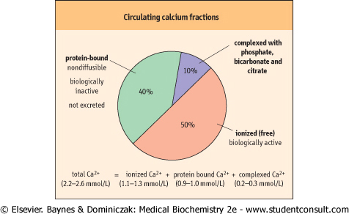

Slide 8
Important note
Only ionized calcium is physiologically active and it is the concentration of ionized calcium that is maintained by homoeostatic mechanisms.

Slide 9
Alkalosis and ionized calcium concentration
In alkalosis, hydrogen ions dissociate from albumin, and calcium binding to albumin increases.
As a result, the concentration of ionized calcium falls.
This may be sufficient to produce clinical symptoms and signs of hypocalcaemia although total plasma calcium concentration is unchanged.
The most frequently used methods for determining plasma calcium concentration measure total calcium.

Slide 10
Effect of albumin on calcium concentration
If serum albumin concentration increases (as in dehydration and after prolonged venous stasis), albumin-bound calcium and total serum calcium increase.
In this case, ionized calcium concentration may be within the normal range.
In conditions of reduced serum albumin (e.g. liver disease, nephrotic syndrome, malnutrition), the protein-bound calcium concentration is reduced, decreasing the total calcium.
Again, ionized calcium is maintained within the normal range.

Slide 11
“Corrected” plasma calcium concentration
Because of the previous discussion, in clinical situations it is important to calculate the ‘corrected calcium' , corrected for the patient's prevailing albumin concentration.

Slide 12
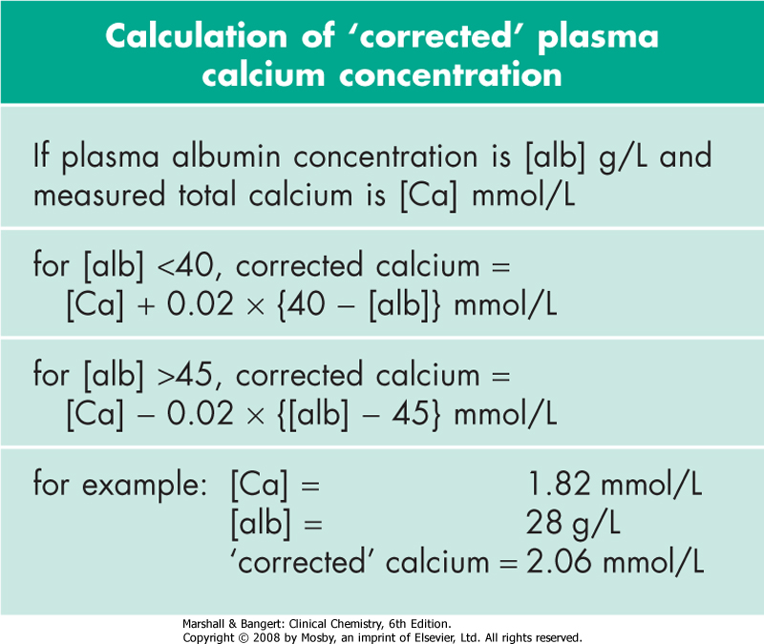
Equation for calculating corrected calcium concentration

Slide 13
Calcium regulating hormones
Plasma calcium concentration is normally maintained within narrow limits by a control system involving two hormones: parathyroid hormone (PTH) and active form of vitamin D (1,25-dihydroxycholecalciferol).
These hormones also control the inorganic phosphate concentration of the plasma.
Calcitonin probably has only a minor role in calcium homoeostasis

Slide 14
Parathyroid hormone (PTH)
Parathyroid hormone responds to changes in ionized calcium and phosphate
PTH is an 84-amino-acid, single-chain peptide hormone secreted by the chief cells of the parathyroid glands.
What are the factors that affect the release of PTH?
1. A decrease in extracellular ionized calcium stimulate its secretion.
2. An increase in serum phosphate concentration stimulates its secretion.
3. Chronic severe magnesium deficiency can inhibit its release from secretory vesicles.
4. low concentrations of 1,25(OH)2D3 interfere with its synthesis.

Slide 15
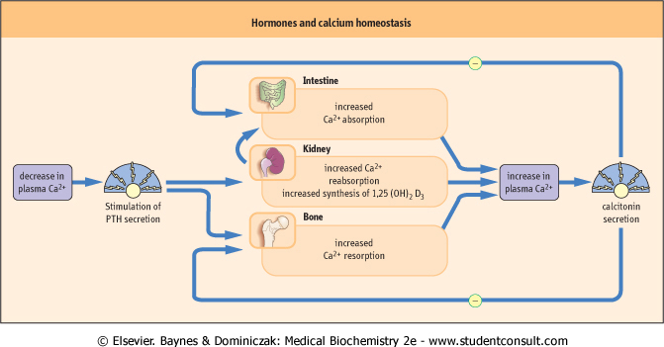
Downloaded from: StudentConsult (on 29 May 2010 04:26 AM)
© 2005 Elsevier

Slide 16
Parathyroid hormone
PTH(1-84) is mainly metabolized into a biologically active PTH(1-34) aminoterminal fragment and an inactive carboxy-terminal fragment, PTH(35-84).
PTH regulates serum calcium concentrations by:
1. Direct actions on bone and kidney.
2. indirect actions on the intestine by increasing the synthesis of active form of vitamin D.

Slide 17
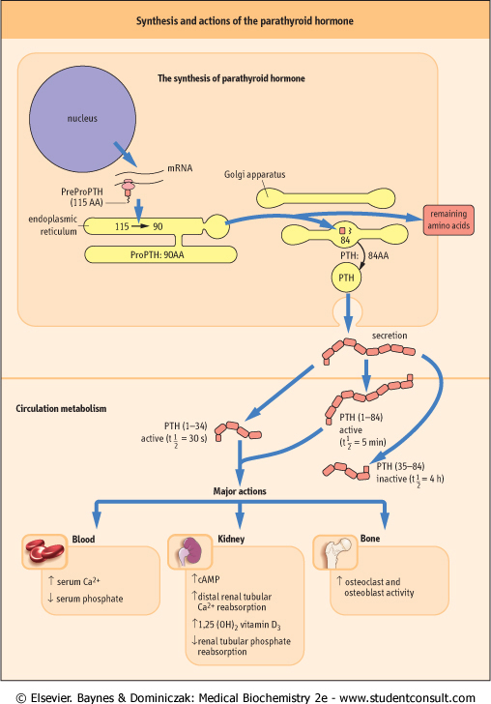

Slide 18
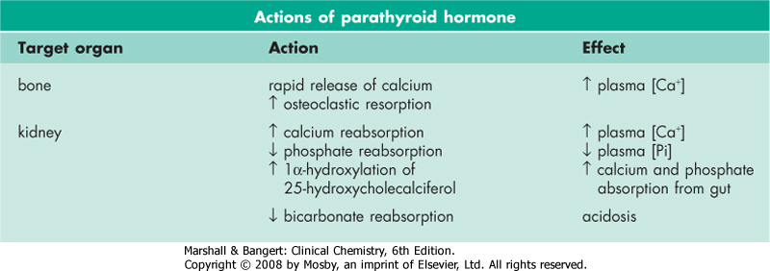

Slide 19
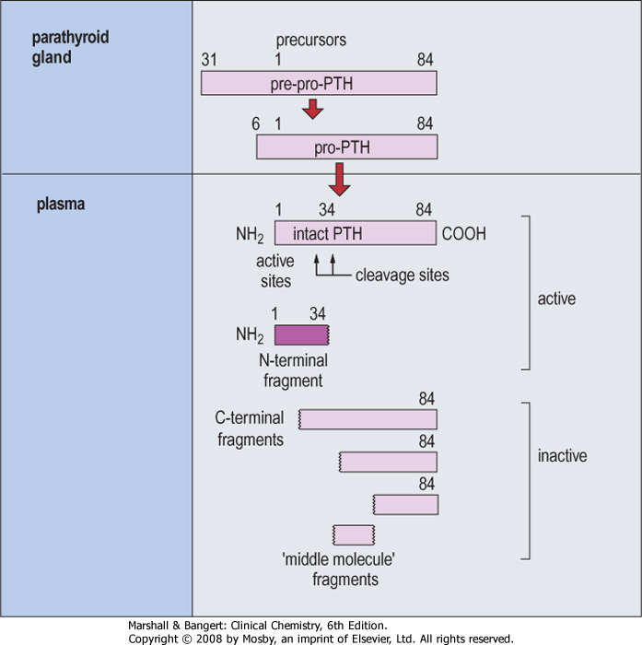

Slide 20
Vitamin D
It should first be noted that vitamin D is in reality a hormone.
Vitamin D shares striking similarities in origin with steroid hormones. Vitamin D is a metabolic product of the cholesterol synthetic pathway.
The tissues that are involved in the synthesis of vitamin D are the skin, liver, and kidneys.
The tissues it affects are the gut, bone, and parathyroids.

Slide 21
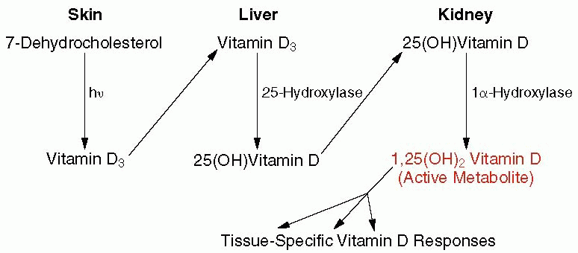

Slide 22
Vitamin D synthesis
1. Synthesis of vitamin D3
De novo synthesis of vitamin D begins in the skin, where 7-dehydrocholesterol is transformed to vitamin D3 by the action of ultraviolet light.
Vitamin D3 is biologically inert and must be further metabolized to the biologically active metabolite.

Slide 23
2. Hydroxylation at carbon 25 in the liver
An enzyme in the liver, 25-hydroxylase, metabolizes vitamin D3 to 25-hydroxy vitamin D.
Hepatic 25-hydroxylase is not regulated by any component of the calcium homeostatic system and functions at all times to hydroxylate vitamin D3 at the 25-position.
Serum 25-hydroxy vitamin D indicates the adequacy of vitamin D stores in the body.

Slide 24
Hydroxylation at carbon 1 in the kidneys
The main site for further hydroxylation at the 1-position are the renal tubules, although bone and the placenta can also carry out this reaction.
1,25(OH)₂D₃ is the most potent of the vitamin D metabolites and the only naturally occurring form of vitamin D that is active at physiologic concentrations.
The 1α-hydroxylase activity is stimulated by PTH, low serum concentrations of phosphate or calcium, vitamin D deficiency, calcitonin, growth hormone, prolactin, and estrogen
The activity of 1α-hydroxylase is feedback-inhibited by 1,25(OH)2D3, hypercalcemia, high phosphate and hypoparathyroidism.

Slide 25
1,25(OH)₂D₃ increases serum concentrations of calcium and phosphate
1,25(OH)₂D₃ increases the absorption of calcium and phosphate from the gut via active transport by calcium-binding proteins.
Together with PTH, it stimulates bone resorption by osteoclasts.
These effects increase serum calcium and phosphate concentrations.
Low 1,25(OH)₂D₃ causes abnormal mineralization of newly formed osteoid.
This is a result of low calcium and phosphate availability and reduced osteoblast function, which result in rickets (in infants and children) or osteomalacia (in adults).

Slide 26
Other hormones that affect calcium metabolism
Several hormones whose primary action is not related to calcium regulation directly or indirectly affect calcium homeostasis and skeletal metabolism.
1. Thyroid hormone stimulates osteoclast-mediated resorption of bone.
2. Estrogen in women and testosterone in men, increase osteoblast and decrease osteoclast function. They also decrease renal calcium and phosphate excretion and intestinal calcium excretion.

Slide 27
Hypercalcemia
Hypercalcemia is the state of blood calcium levels above the expected normal range.
Two conditions account for up to 90% of cases: primary hyperparathyroidism and malignancy.
Hypercalcaemia is often clinically silent and discovered incidentally when calcium is measured as part of a biochemical profile.

Slide 28
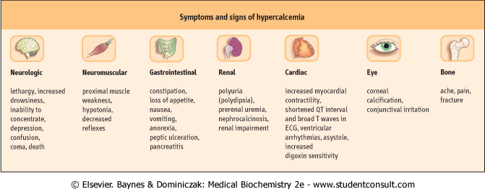

Slide 29
Malignant disease as a cause of hypercalcemia
This is a very common cause of hypercalcaemia, particularly in patients in hospital.
There may or may not be obvious metastases in bone.
With most solid tumours, it is due to the secretion by the tumour of PTH-related peptide (PTHrP).
This is a peptide having some N-terminal amino acid sequence homology with PTH.
Because PTHrP shares the N-terminal sequence homology with PTH, it acts similarly and can cause hypercalcemia
Other humoral factors can also cause hypercalcemia such as transforming growth factors, prostaglandins and, particularly in haematological malignancies, osteoclast-activating cytokines .
As one would expect, PTHrP-mediated hypercalcemia is associated with a low concentration of PTH.

Slide 30
Hypercalcemia
2. Primary hyperparathyroidism
Primary hyperparathyroidism is the most common cause of hypercalcemia in the outpatient setting.
It can occur at any age and affects both men and women but is most common in post-menopausal women.
The term primary indicates that the physiologic defect lies with the parathyroid glands themselves.
It is usually due to a parathyroid adenoma, less often to diffuse hyperplasia of the glands, and only rarely to parathyroid carcinoma

Slide 31
Primary hyperparathyroidism
Result of biochemical investigations
an individual with primary HPT would be expected to have:
1. hypercalcemia (ideally measured as ionized calcium).
2. Elevated or inappropriately normal PTH.
3. increased urinary calcium excretion.
4. hypophosphatemia

